Slide 1
Bike-Sharing Assignment
Prepared By:
Mohammad Aftab Alam

Slide 2
About
This assignment is a programming assignment wherein I have build a multiple linear regression model for the prediction of demand for shared bikes by using Python, Jupyter Notebook, Matplotlib, Pandas, Numpy, Scikit-Learn, Statsmodels, Seaborn.
Scenario/Problem Statement:
A bike-sharing system is a service in which bikes are made available for shared use to individuals on a short term basis for a price or free. Many bike share systems allow people to borrow a bike from a "dock" which is usually computer-controlled wherein the user enters the payment information, and the system unlocks it. This bike can then be returned to another dock belonging to the same system.
A US bike-sharing provider Boom Bikes has recently suffered considerable dips in their revenues due to the ongoing Corona pandemic. The company is finding it very difficult to sustain in the current market scenario. So, it has decided to come up with a mindful business plan to be able to accelerate its revenue as soon as the ongoing lockdown comes to an end, and the economy restores to a healthy state.

Slide 3
Data Preparation:
You can observe in the dataset that some of the variables like 'weathersit' and 'season' have values as 1, 2, 3, 4 which have specific labels associated with them (as can be seen in the data dictionary). These numeric values associated with the labels may indicate that there is some order to them - which is actually not the case (Check the data dictionary and think why). So, it is advisable to convert such feature values into categorical string values before proceeding with model building. Please refer the data dictionary to get a better understanding of all the independent variables.
You might notice the column 'yr' with two values 0 and 1 indicating the years 2018 and 2019 respectively. At the first instinct, you might think it is a good idea to drop this column as it only has two values so it might not be a value-add to the model. But in reality, since these bike-sharing systems are slowly gaining popularity, the demand for these bikes is increasing every year proving that the column 'yr' might be a good variable for prediction. So think twice before dropping it.

Slide 4
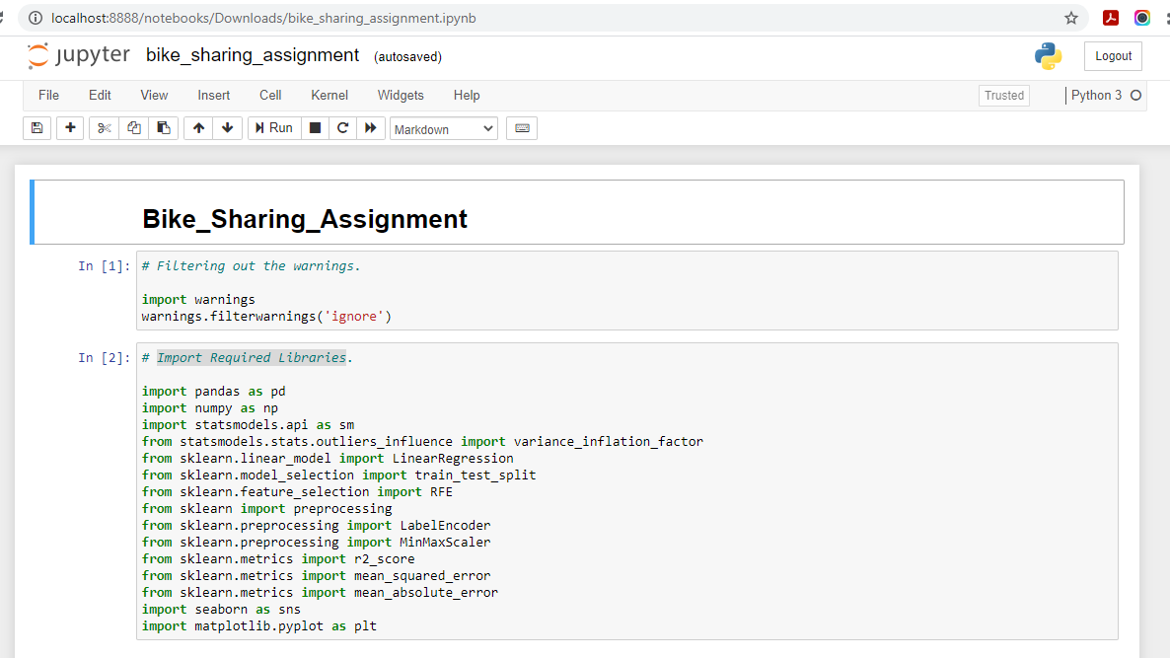
Import Required Libraries

Slide 5
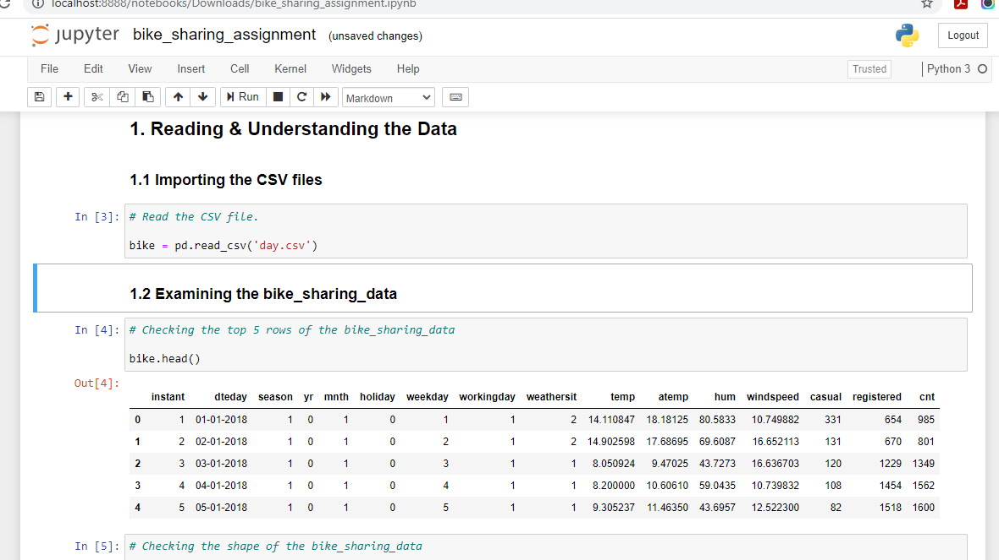
Reading & Understanding the Data

Slide 6
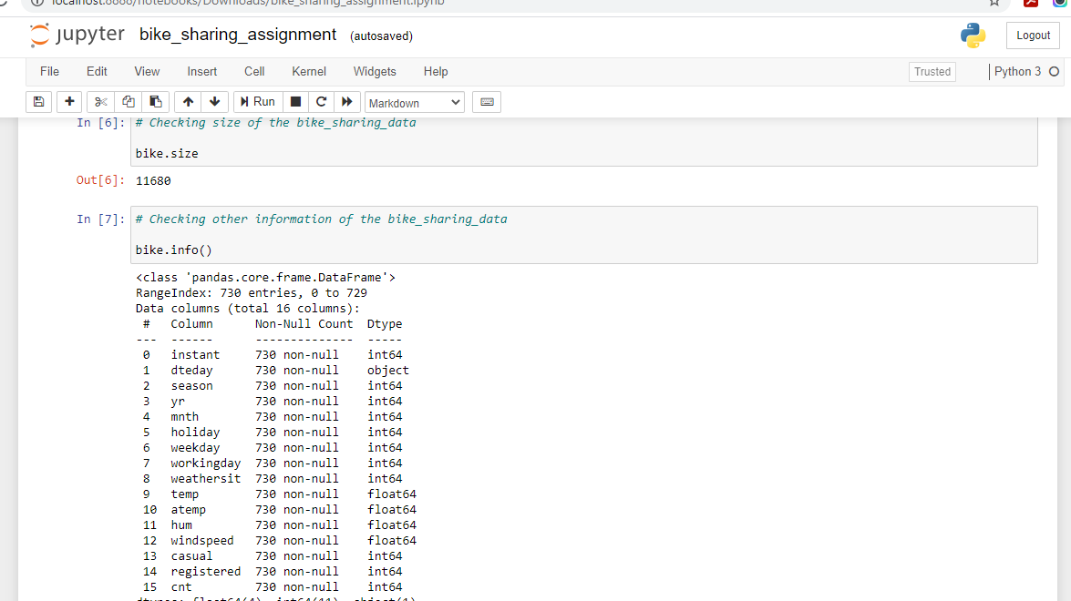

Slide 7
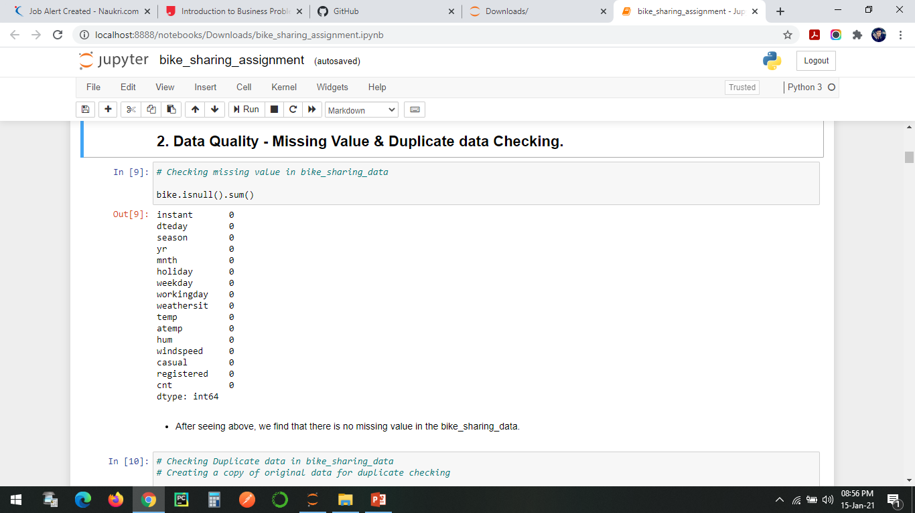
Data Quality - Missing Value & Duplicate data Checking
After seeing above, we find that there is no missing value in the bike_sharing_data

Slide 8
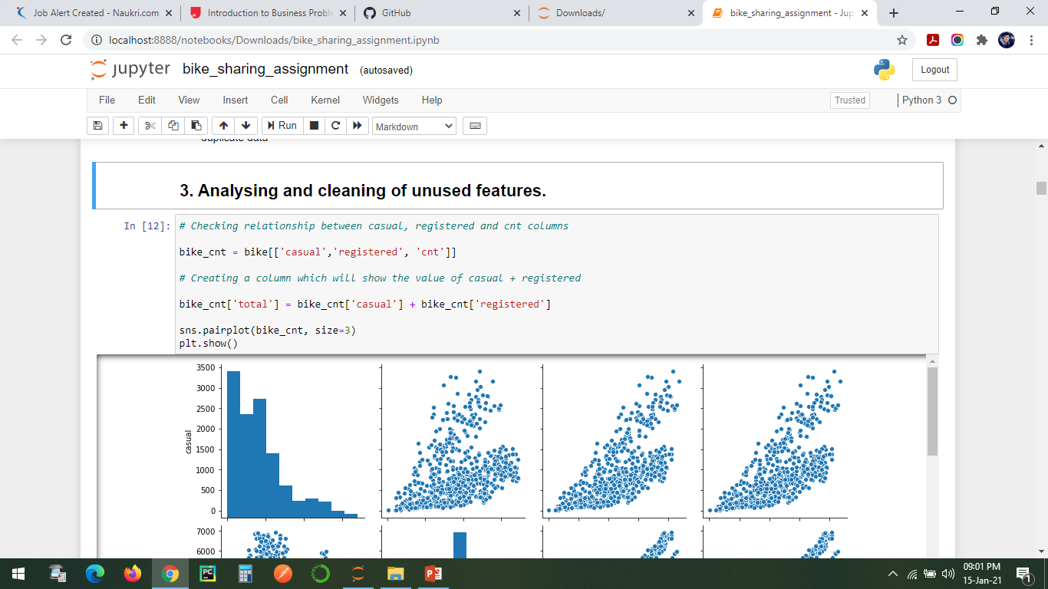
Analysing and cleaning of unused features through Pairplot.

Slide 9
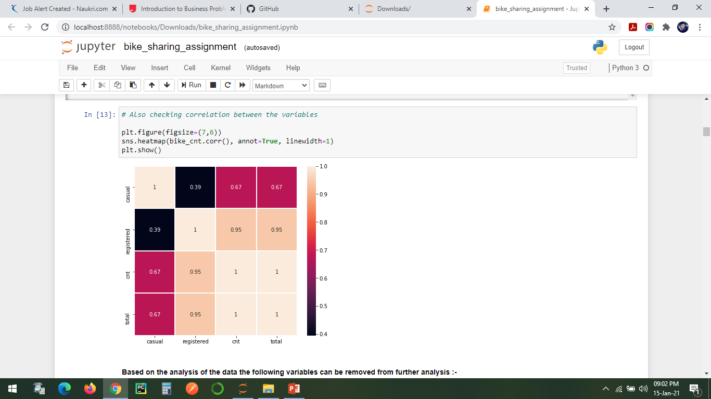
Analysing and cleaning of unused features Heatmap
Based on the analysis of the data the following variables can be removed from further analysis :-
Instant
Dteday
casual & registered-

Slide 10
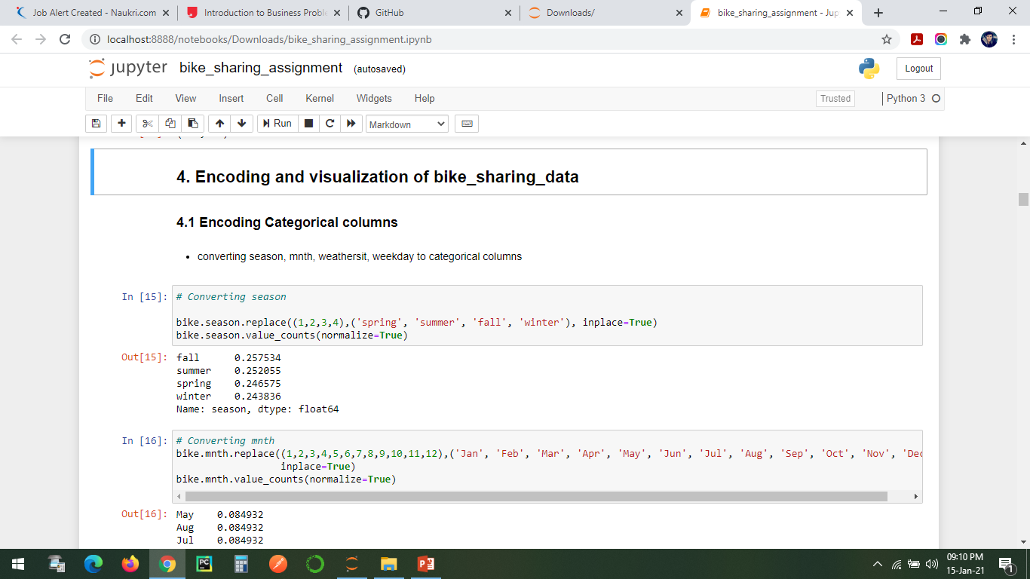
Encoding and visualization of bike_sharing_data
Encoding Categorical columns

Slide 11
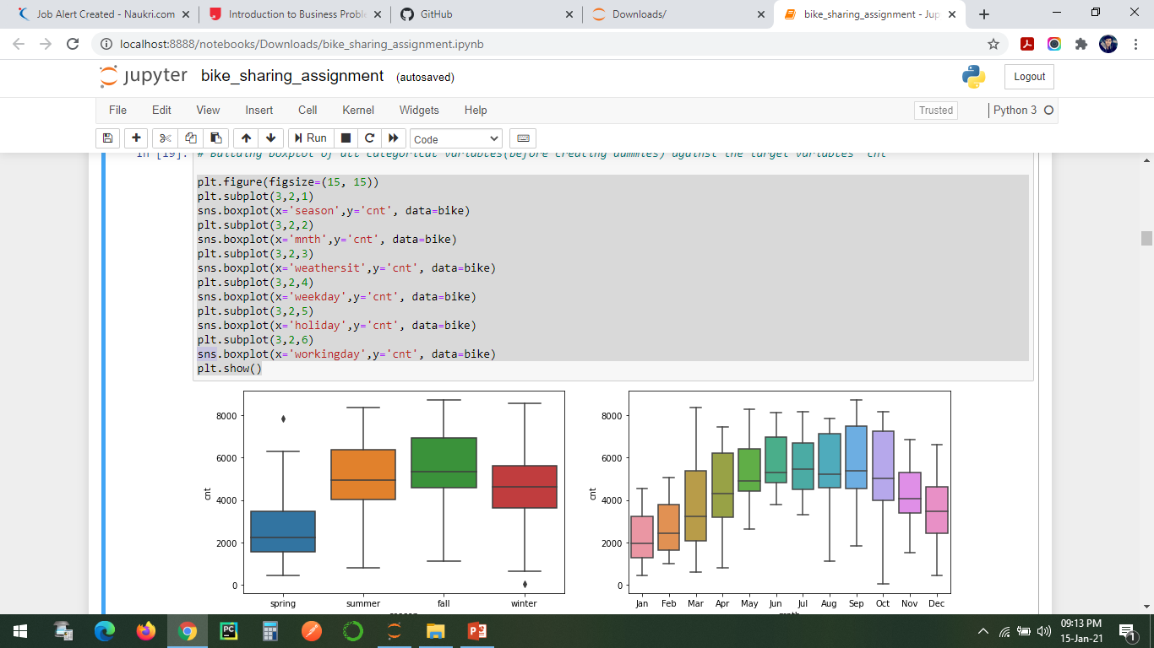
Categorical Variables Analysis

Slide 12
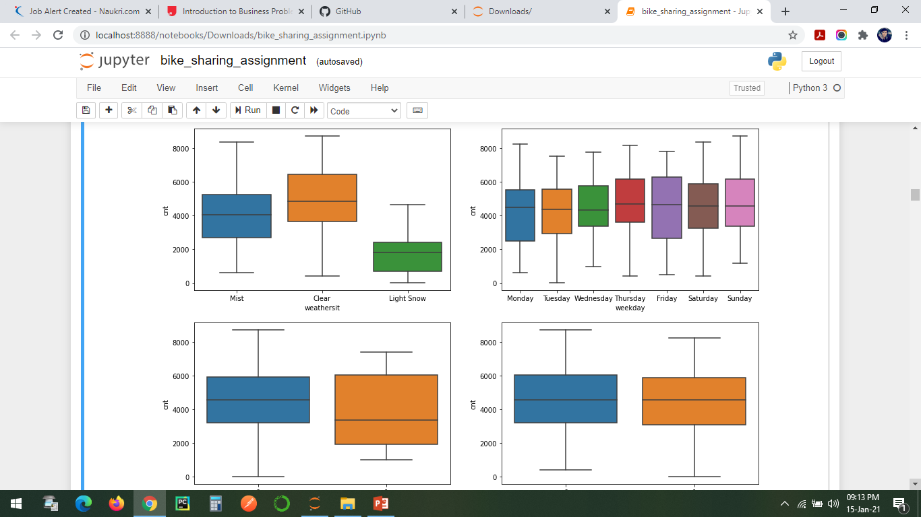

Slide 13
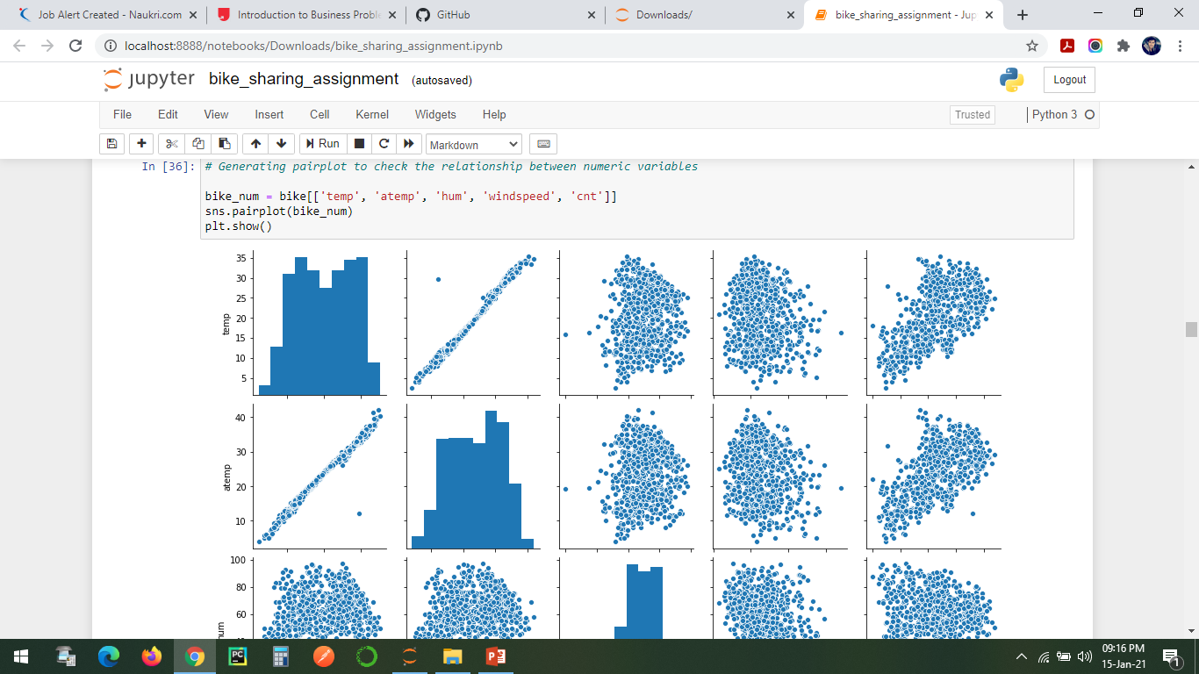
Numerical Variables Analysis through Pairplot

Slide 14
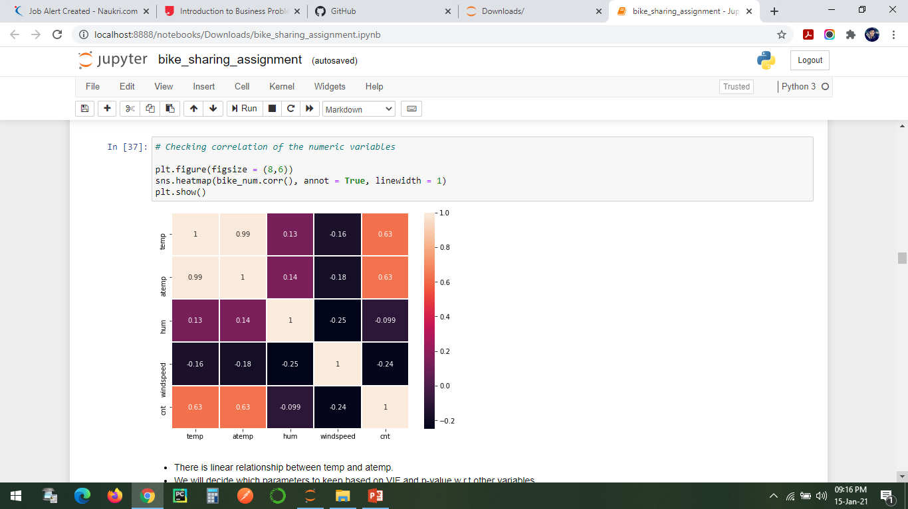
Numerical Variables Analysis through Heatmap

Slide 15
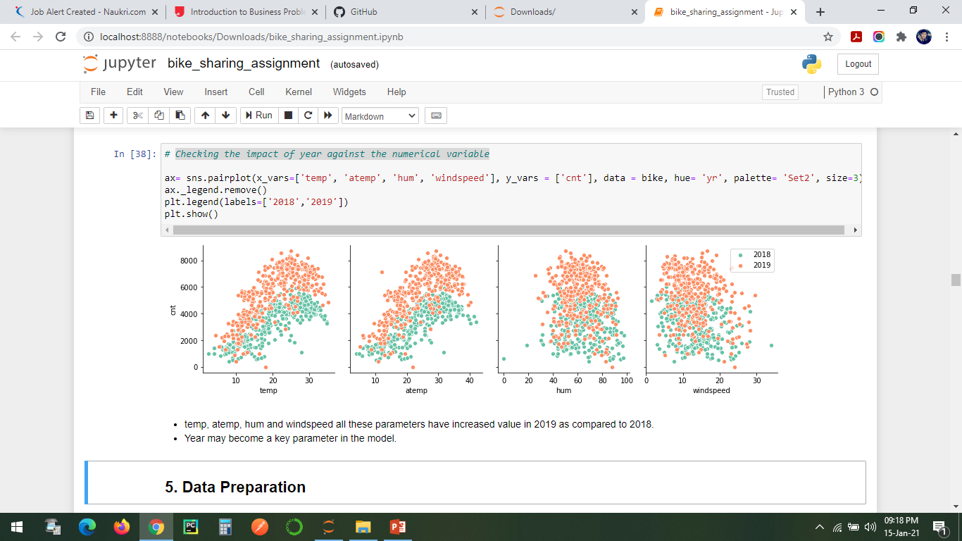
Checking the impact of year against the numerical variable
temp, atemp, hum and windspeed all these parameters have increased value in 2019 as compared to 2018.
Year may become a key parameter in the model.

Slide 16
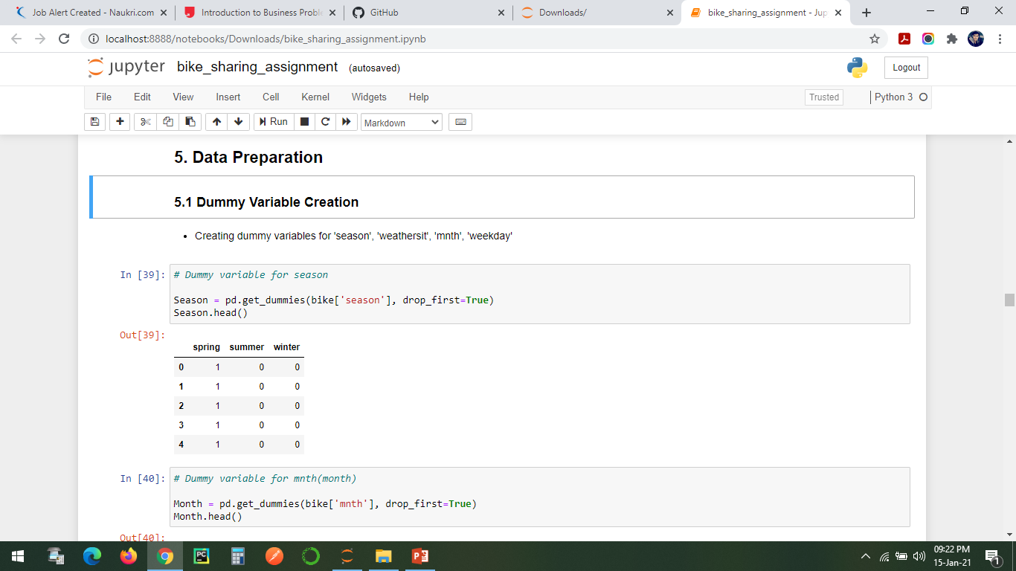
Data Preparation
Dummy Variable Creation

Slide 17
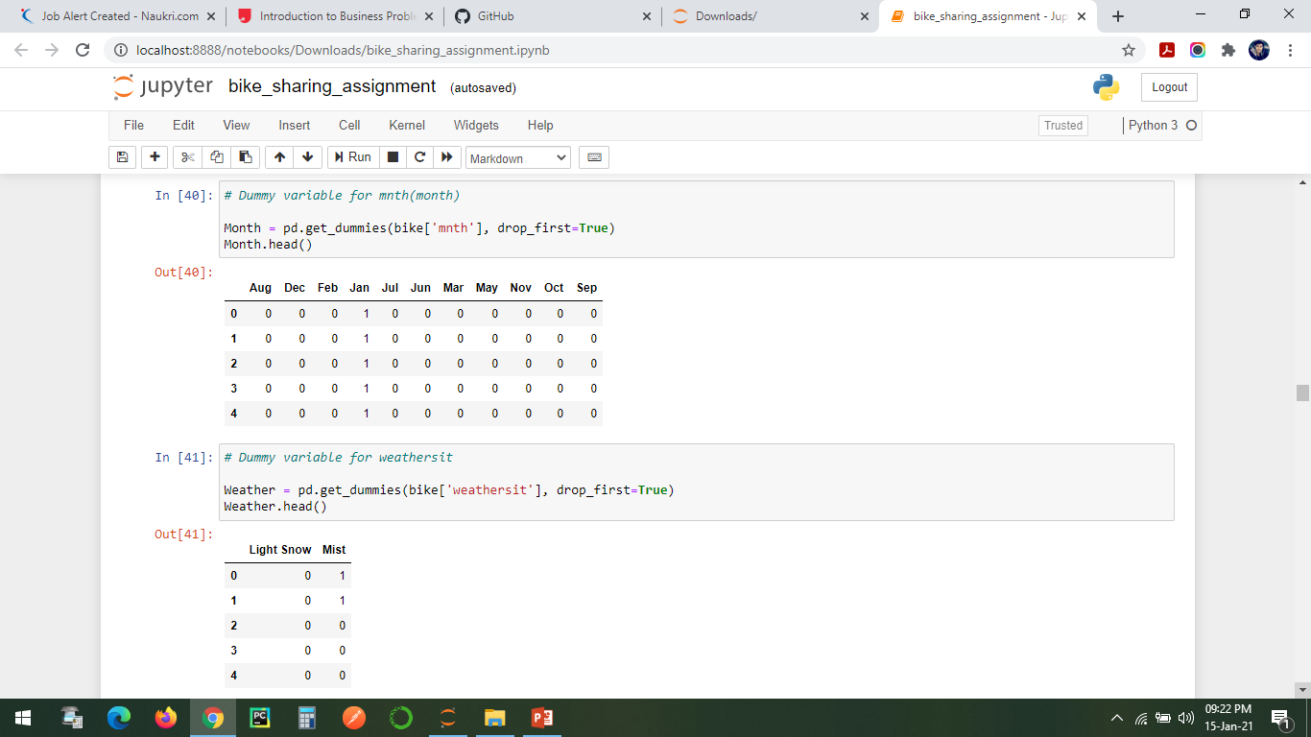

Slide 18
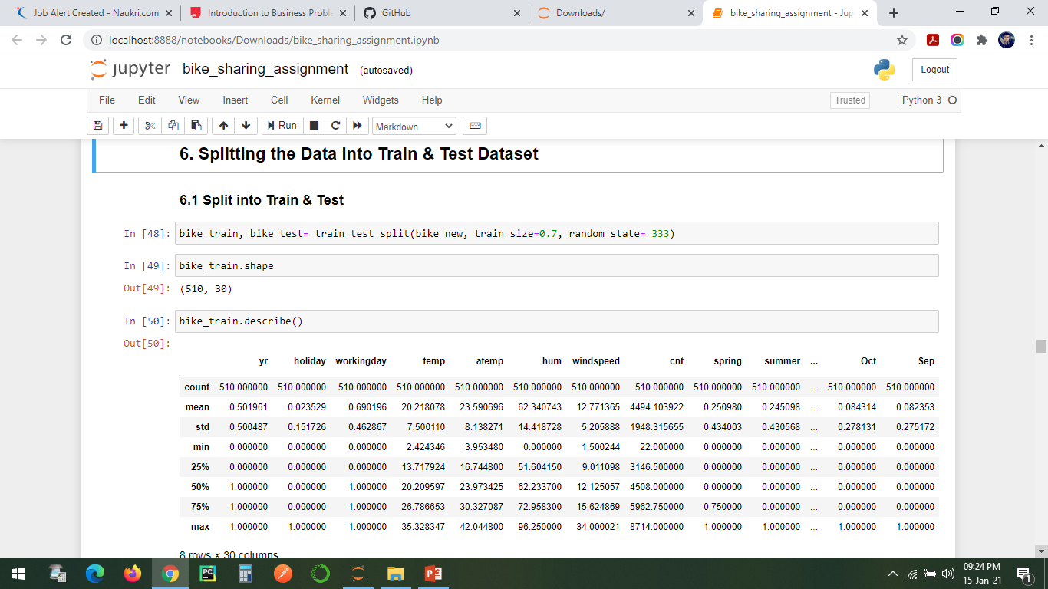
Splitting the Data into Train & Test Dataset

Slide 19
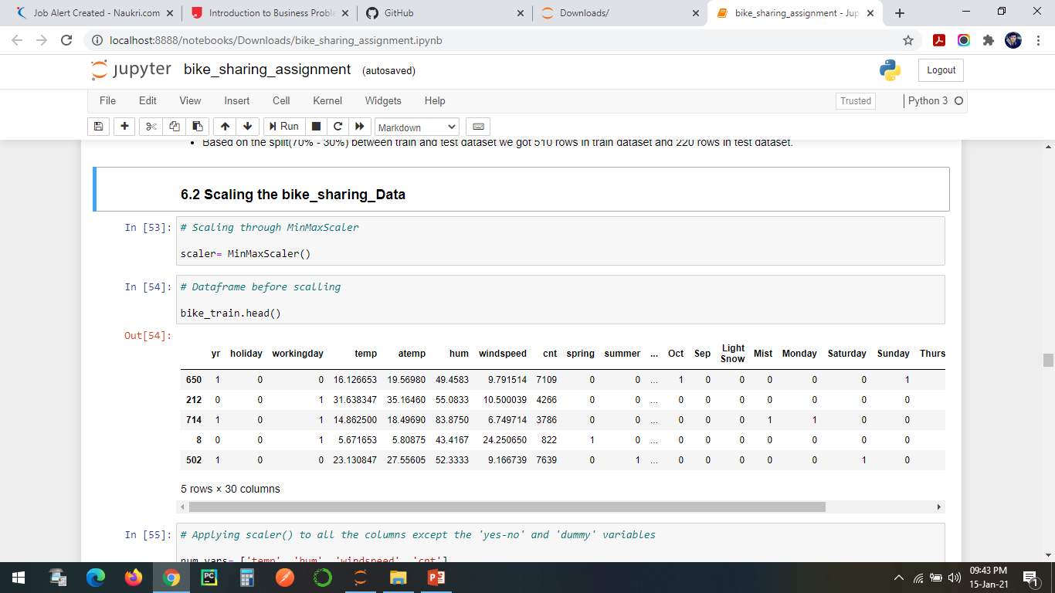
Scaling the bike_sharing_Data

Slide 20
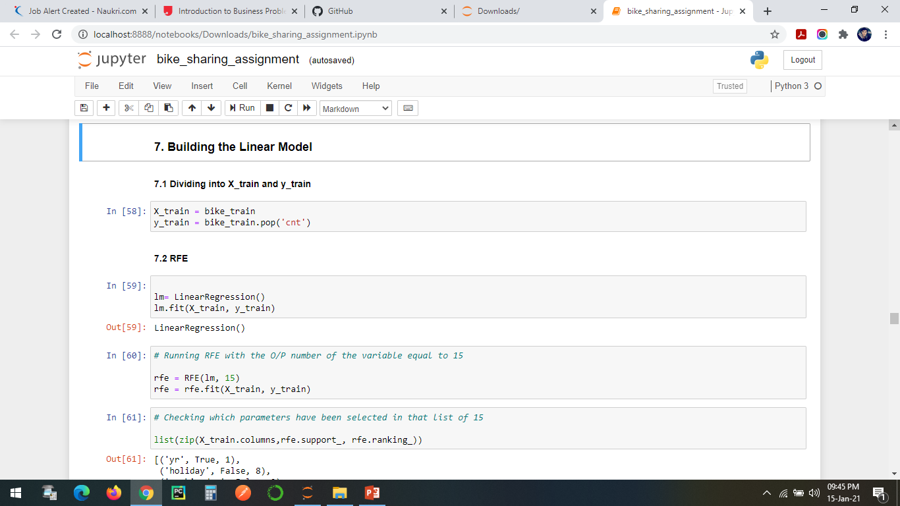
Building the Linear Model

Slide 21
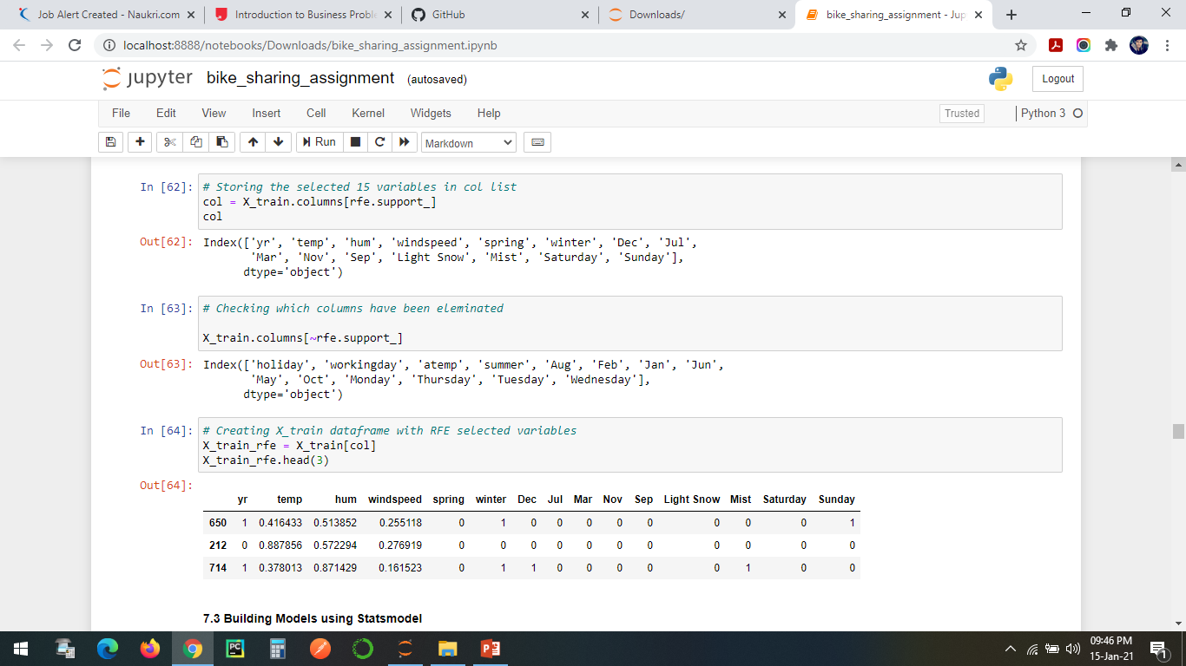

Slide 22
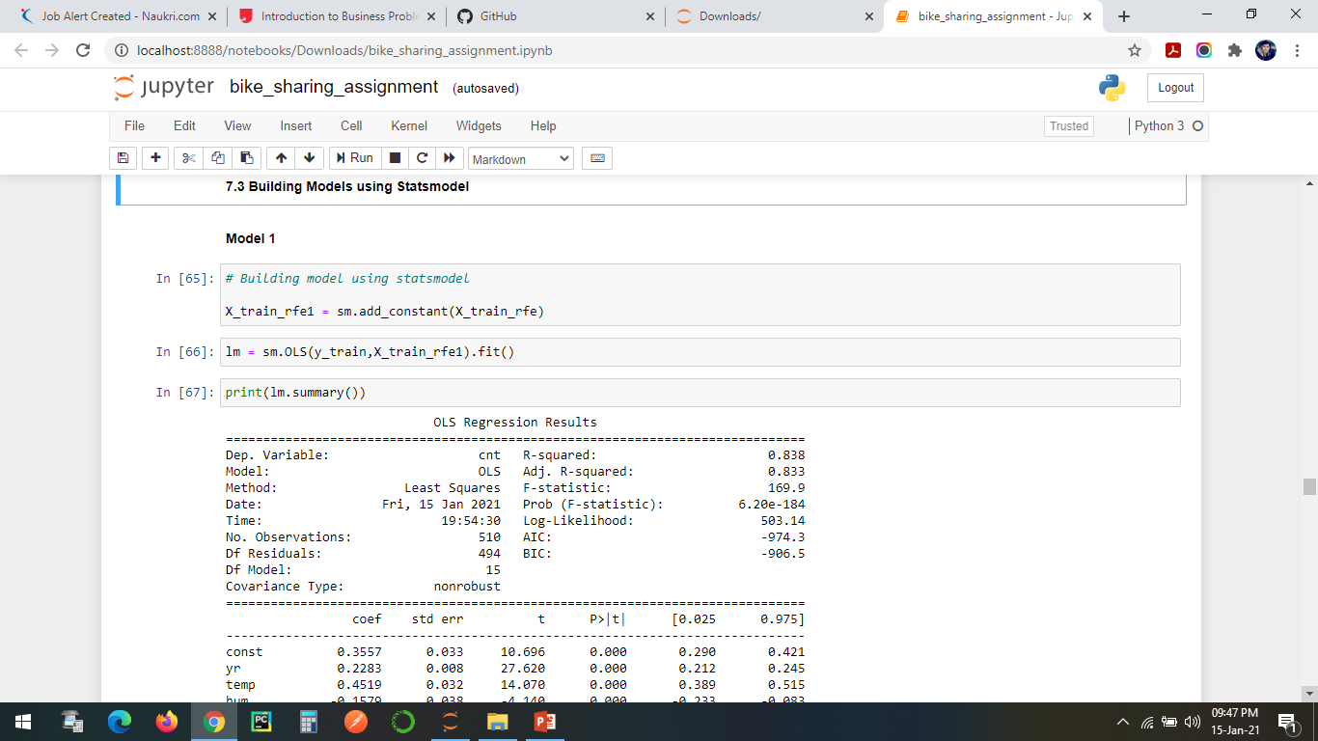
Building Models using Statsmodel

Slide 23
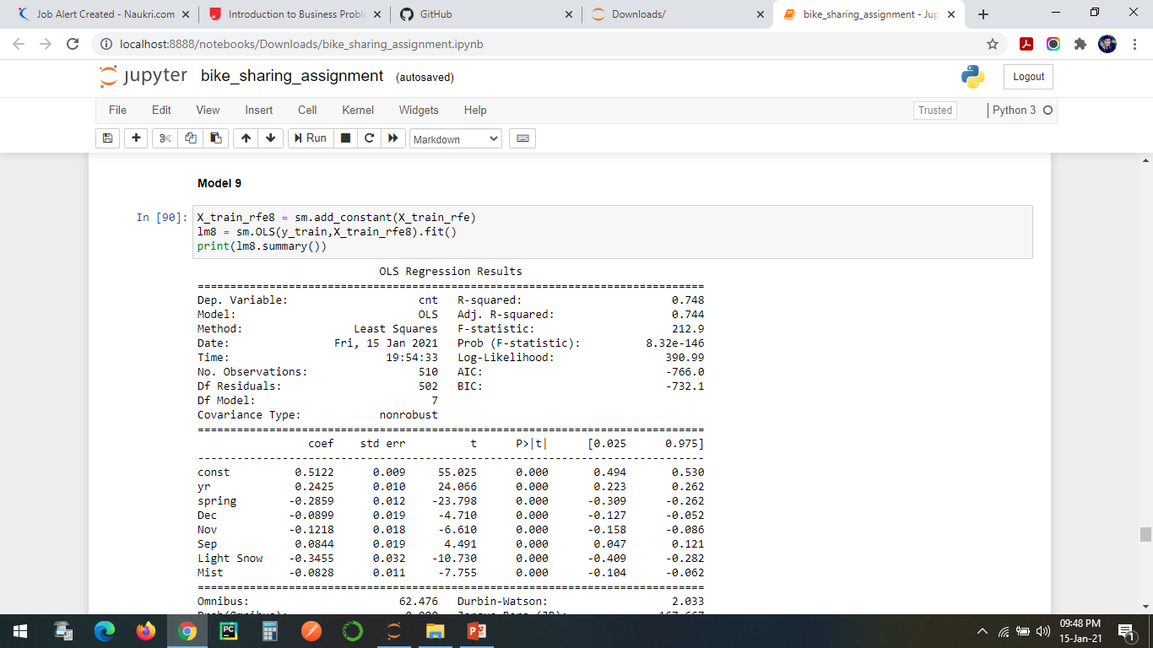
Final Model

Slide 24
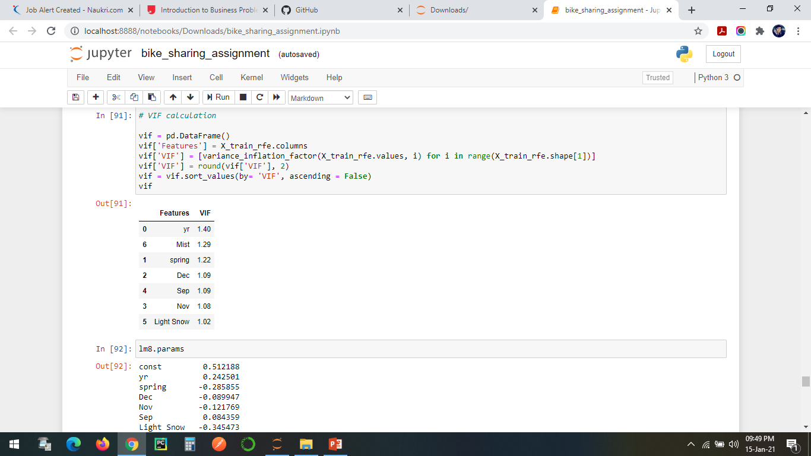

Slide 25
Conclusion for 'Final Model' after seeing above results:-
This model looks good, as there seems to be very low Multicollinearity between the predictors.
P-value for all the predictors seems to be significant.
For now, we will consider this as our Final Model unless the Test data metrics are not significantly close to this number
F-Statistics
F-Statistics is used for testing the overall significance of the Model.
Higher the F-Statistics, the more significant the Model is.
F-Statistics : 212.9
Prob (F-Statistics) : 8.32e-146
F-Statistics value 0f 212.9 (which is greater than 1) and the p-value of '~0.0000' states that the overall model is significant.

Slide 26
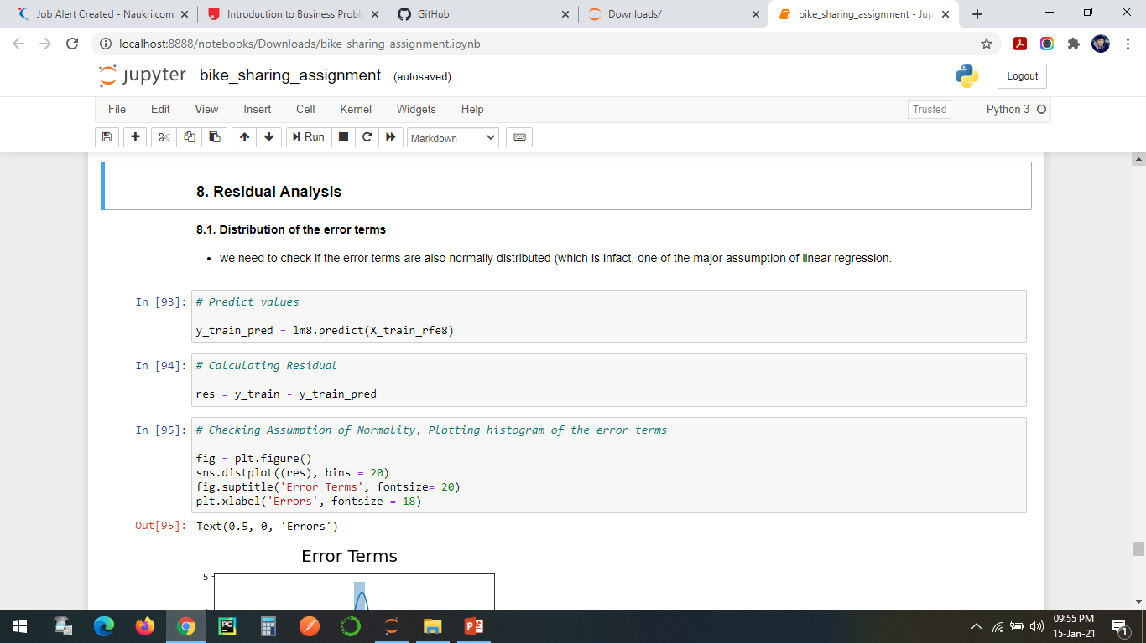
Residual Analysis

Slide 27
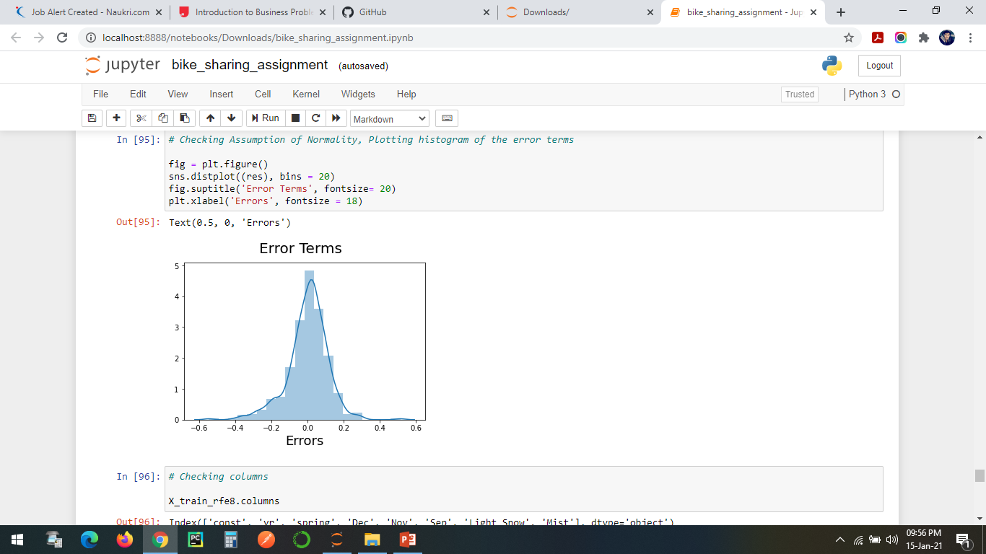
Error Terms

Slide 28
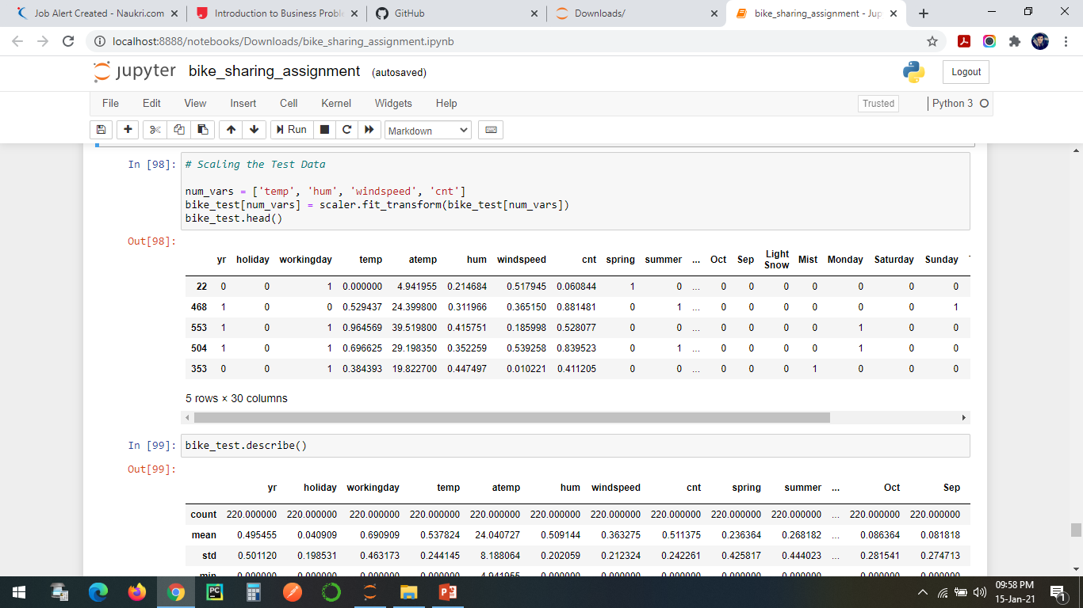
Scaling the test Data

Slide 29
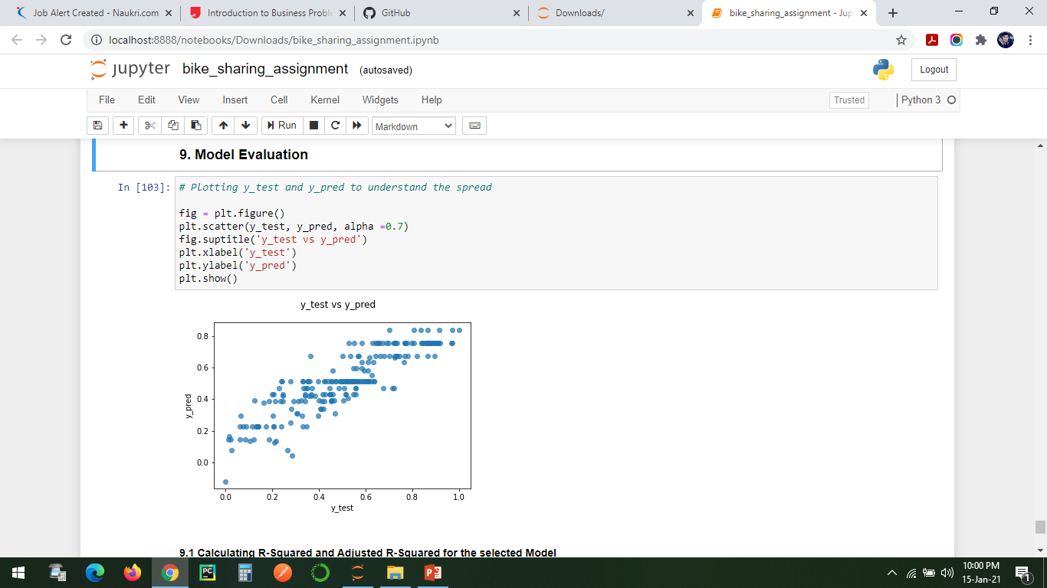
Model Evaluation

Slide 30
